Slide 1
Normal Distribution
Group 2:
Chester Kyles Colita
Limic de la Salzada II
Teepu Cedi Camba

Slide 2
Coin Toss Experiment
Find the probability of getting between 435 and 465 heads in tossing a fair coin 900 times.
Simulate in MATLAB in getting a number of heads after tossing a fair coin 900 times. Repeat this at least 10,000 times. Make a histogram out of it.
Example:
1st test = 435 heads
2nd test = 467 heads
3rd test = 421 heads
.. and so on.
Also, get the value for mean and standard deviation from the attained data during simulation. mean = total/number of trials. standard deviation is the root mean square of the data.

Slide 3
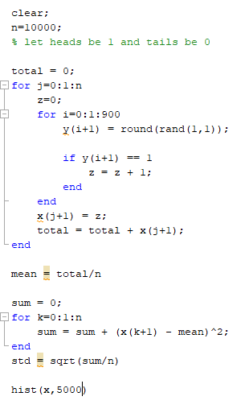
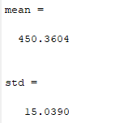
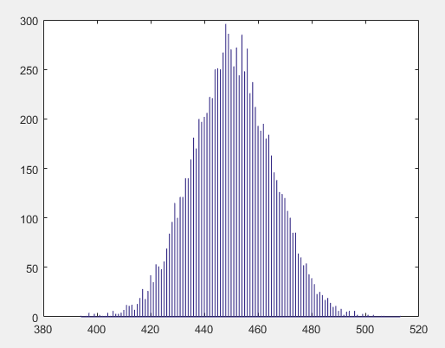
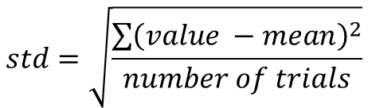

$$mean=\frac{\sum{value}}{number of trials}$$
$$std=\sqrt{\frac{\sum{{\left(value −mean\right)}^{2}}}{number of trials}}$$

Slide 4
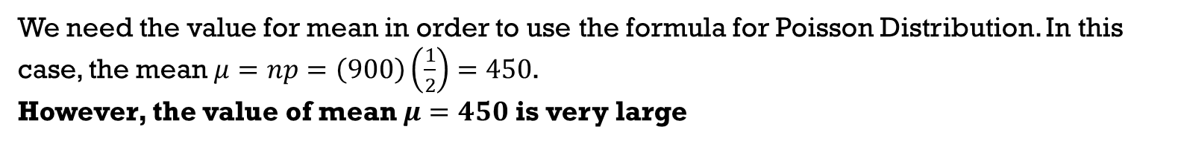
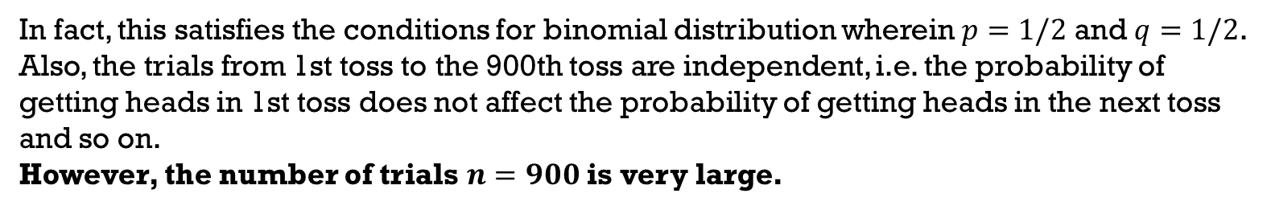
Coin Toss Experiment
Find the probability of getting between 435 and 465 heads in tossing a fair coin 900 times.
Can we use Binomial Distribution?
In fact, this satisfies the conditions for binomial distribution wherein $p=1/2$ and $q=1/2$.
Also, the trials from 1st toss to the 900th toss are independent, i.e. the probability of getting heads in 1st toss does not affect the probability of getting heads in the next toss and so on.
However, the number of trials $n=900$ is very large.
Can we use Poisson Distribution?
We need the value for mean in order to use the formula for Poisson Distribution. In this case, the mean $μ=np=\left(900\right)\left(\frac{1}{2}\right)=450$.
However, the value of mean $μ=450$ is very large

Slide 5
Coin Toss Experiment
Find the probability of getting between 435 and 465 heads in tossing a fair coin 900 times.
For very large number of trials for Binomial Distribution and/or sufficiently large values of mean for Poisson Distribution,
Normal Distribution can be used to approximate Binomial Distribution and/or Poisson Distribution.

Slide 6
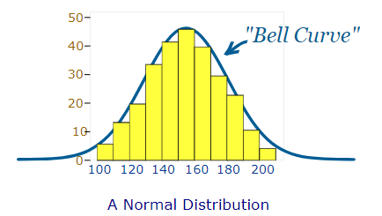
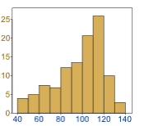
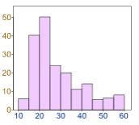
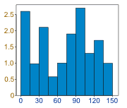

Normal Distribution
A random variable X has the normal distribution with parameters μ and σ², if the density function of X is
$$f\left(x\right)=\frac{1}{σ\sqrt{2π}}e^{− \frac{{\left(x−μ\right)}^{2}}{2σ^{2}}}$$
mean
standard deviation
variance

Slide 7
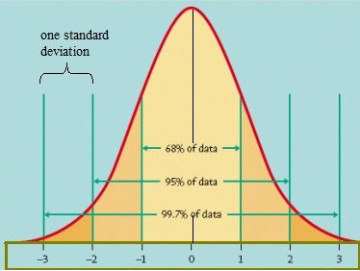
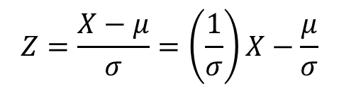
Standardized Normal Distribution
For real μ and σ > 0, the standardized random variable is defined by
A standard normal model is a normal distribution with a mean of 1 and a standard deviation of 1.
$$Z=\frac{X−μ}{σ}=\left(\frac{1}{σ}\right)X−\frac{μ}{σ}$$

Slide 8
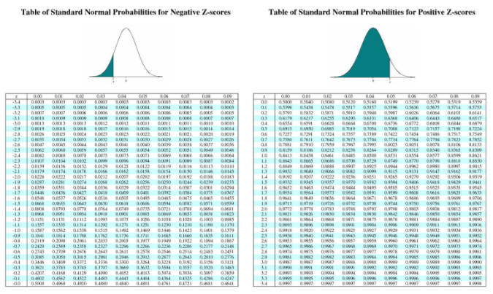
Z-score Table
you can search for z-score table in the Internet
Notes:
P(x<=b) is also the same as P(x<b)

Slide 9
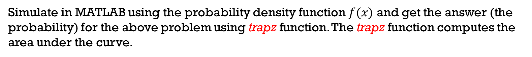
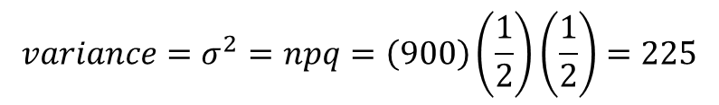
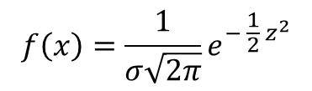
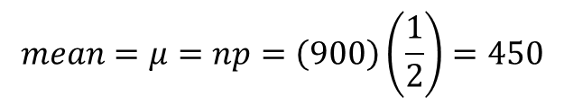

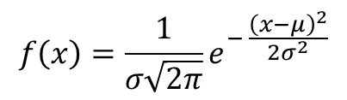
Coin Toss Experiment (cont.)
Find the probability of getting between 435 and 465 heads in tossing a fair coin 900 times.
$$mean=μ=np=\left(900\right)\left(\frac{1}{2}\right)=450$$
$$Z=\frac{X−μ}{σ}$$
$$variance=σ^{2}=npq=\left(900\right)\left(\frac{1}{2}\right)\left(\frac{1}{2}\right)=225$$
$$f\left(x\right)=\frac{1}{σ\sqrt{2π}}e^{− \frac{{\left(x−μ\right)}^{2}}{2σ^{2}}}$$
$$f\left(x\right)=\frac{1}{σ\sqrt{2π}}e^{− \frac{1}{2} z^{2}}$$
$$standard deviation=σ=\sqrt{npq}=\sqrt{225}=15$$
Simulate in MATLAB using the probability density function $f(x)$ and get the answer (the probability) for the above problem using trapz function. The trapz function computes the area under the curve.

Slide 10
Activity 1
A group of graduate students took an examination in Probability and Statistics and the final scores have a mean of 70 and a standard deviation of 10. The passing score of the examination is 60. If we can approximate the distribution of these scores by a normal distribution (use the standard normal curve if possible),
a.) what percent of the students scored higher than 80?
b.) what percent of the students should pass the examination?
c.) what percent of the students should fail the examination?
d.) what percent of the students should pass the examination but scored lesser than 80?
e.) and the top 5% will be rewarded with incentives, what is the boundary grade in getting the reward?
f.) and the bottom 20% will retake the examination, what range of grades would fall to this category? (you can search for z-score table in the Internet)

Slide 11



Activity 2
The average male drinks 2L of water when active outdoors (with a standard deviation of 0.7 L). You are planning a full day nature trip for 50 men and will bring 110 L of water. What is the probability that you will run out of water?
For a sampling distribution problem, note that:
$$μ_{\overline{x}}=μ$$
$$σ_{\overline{x}}^{ 2}= \frac{σ^{2}}{N}$$
$$σ_{\overline{x}} = \frac{σ}{\sqrt{N}}$$
Simulate the above problem in MATLAB.
a.) If the mean is changed to 1.8L and the standard deviation is unchanged, what would be the probability now?
b.) If the mean is changed back to 2L and the standard deviation is changed to 0.5L, what would be the probability now?
Graph a family of curves of the three different scenarios. Explain the graph.

Slide 12
Thank you!
Group 2:
Chester Kyles Colita
Limic de la Salzada II
Teepu Cedi Camba

